Slide 1
Purpose Beyond Programming
Mark Kovacevich, President Improving

Slide 2
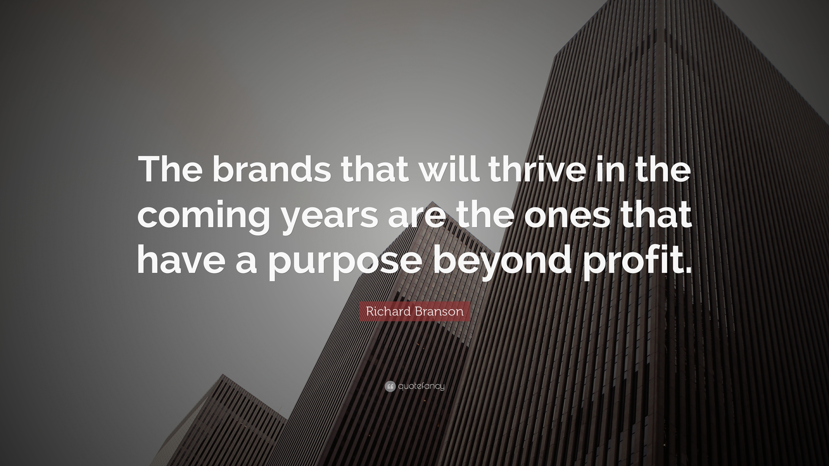
Purpose Beyond Profit

Slide 3

Mark Kovacevich

Slide 4

Capitalism is….. Good??

Slide 5
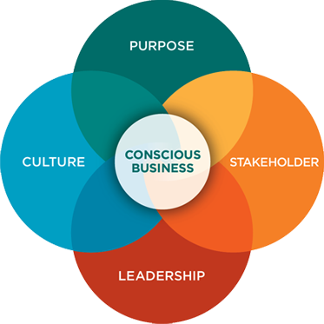
Four Pillars of Conscious Capitalism

Slide 6
Conscious Purpose
Conscious businesses focus on their purpose beyond profit.
Purpose
Purpose engages all stakeholders
Business with a purpose beyond profit
People trust companies motivated by a higher cause
Notes:
Purpose: While making money is essential for the vitality and sustainability of a business, it is not the only reason a business exists. Conscious businesses also focus on their purpose beyond profit. Purpose activates us and motivates us.
What does that mean?
Example: We need air to breathe, but the purpose of life is not to breathe air.
Why is that important?
Profit is essential to a company, but not the purpose for which the business exists
purpose activates and motivates. It engages all stakeholders.
people love and trust companies with purpose (the company not driven by selfishness)
Example:
Southwest- make air travel accessible to the average person. 1970’s only 15 percent of Americans had flown. Now more than 85% have flown. Pioneered efforts for lower air fares, service in smaller markets, (southwest has been consistently profitable since they started operations )

Slide 7
Stakeholder Orientation
Conscious businesses recognize the importance of creating value for the entire business ecosystem.
Stakeholder
Focus on stakeholders not shareholders
Engaged stakeholders, healthy business
Notes:
Stakeholder: Unlike businesses that believe their only focus is to maximize return for their shareholders, conscious businesses recognize the importance of creating value for the entire business ecosystem (employees, customers, suppliers, funders, communities, etc.)
What does that mean?
business is an intricate and interconnected web of relationships-everyone who interacts with your business. Clients, Employees, Shareholders, Vendors etc. These are your stakeholders
If the purpose of business isn’t just to make money, then it makes sense the focus isn’t just providing value to shareholders, but to the entire business ecosystem.
Why is that important?
strong engaged stakeholders help a business stay healthy.
win-win-win proposition with a healthy return for shareholders.
Example:
John Mackey of whole foods was asked- who is most important in a company- the share holders? He said No!
The employee is the most important. I take care of my employees and they take care of our customers and our customers take care of the shareholders

Slide 8
Conscious Leadership
Conscious leaders purposefully cultivate an environment of trust, care and service.
Leadership
servant leadership
serve the purpose of the company
support people
create value for stakeholders.
focus on “we” not “me”
Notes:
Leadership: the leaders of conscious businesses understand the integral role of culture and purposefully cultivate a an environment of trust , care and service for their entire business ecosystem.
What does that mean?
Leaders role:
Good leaders are servants
They serve the purpose of the company.
They support people
They bring the best out in those around them
They create value for stakeholders.
They focus on we not me.
Example: Simon Sinek- “In the military, they give medals for people who are willing to sacrifice themselves so that others may survive, in business we give bonuses to people who sacrifice others.”
Why is this important?
A leader sets the tone for the organization and they have a strong influence on the health of the culture. Which directly impacts the happiness of the stakeholders and ultimately the success of the business

Slide 9
Conscious Culture
Culture is the guiding principles and practices of a business.
Culture
Interconnected people, purpose, process
Fosters love, care, trust between all company stakeholders
Notes:
Culture: Culture is the guiding principles and practices underlying the social fabric of a business. Healthy conscious cultures connect the stakeholders to each other and to the company’s purpose, people and processes.
What does that mean?
A conscious culture embodies the espoused values and principles upheld by the company.
A conscious culture fosters love, care, trust between all company stakeholders.
Example:
Barry Wehmiller- Everyone in the workforce is someone’s precious child
Why is it important?
The health of the organization is dependent on culture. The culture determines assumptions and behaviors of the stakeholders which those behaviors drive the results of the company.
Example: Nordstrom Rules- only one. Use good judgement at all times

Slide 10
Conscious Capitalism
Purpose: Energize stakeholders around a higher purpose while maintaining the essential ingredient of profitability.
Culture: Connect stakeholders to each other and the company’s purpose through shared values inherent in the people, processes, and practices of the business.
Leadership: Purposefully cultivate an environment of trust, care and service for the entire business ecosystem.
Stakeholder: Focus on stakeholders rather than shareholders and create value for all involved.

Slide 11

Why do I Need Personal Purpose Statement?

Slide 12
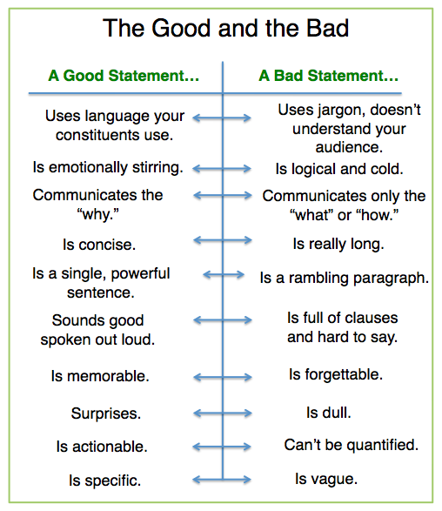
Key Attributes of a Purpose Statement

Slide 13
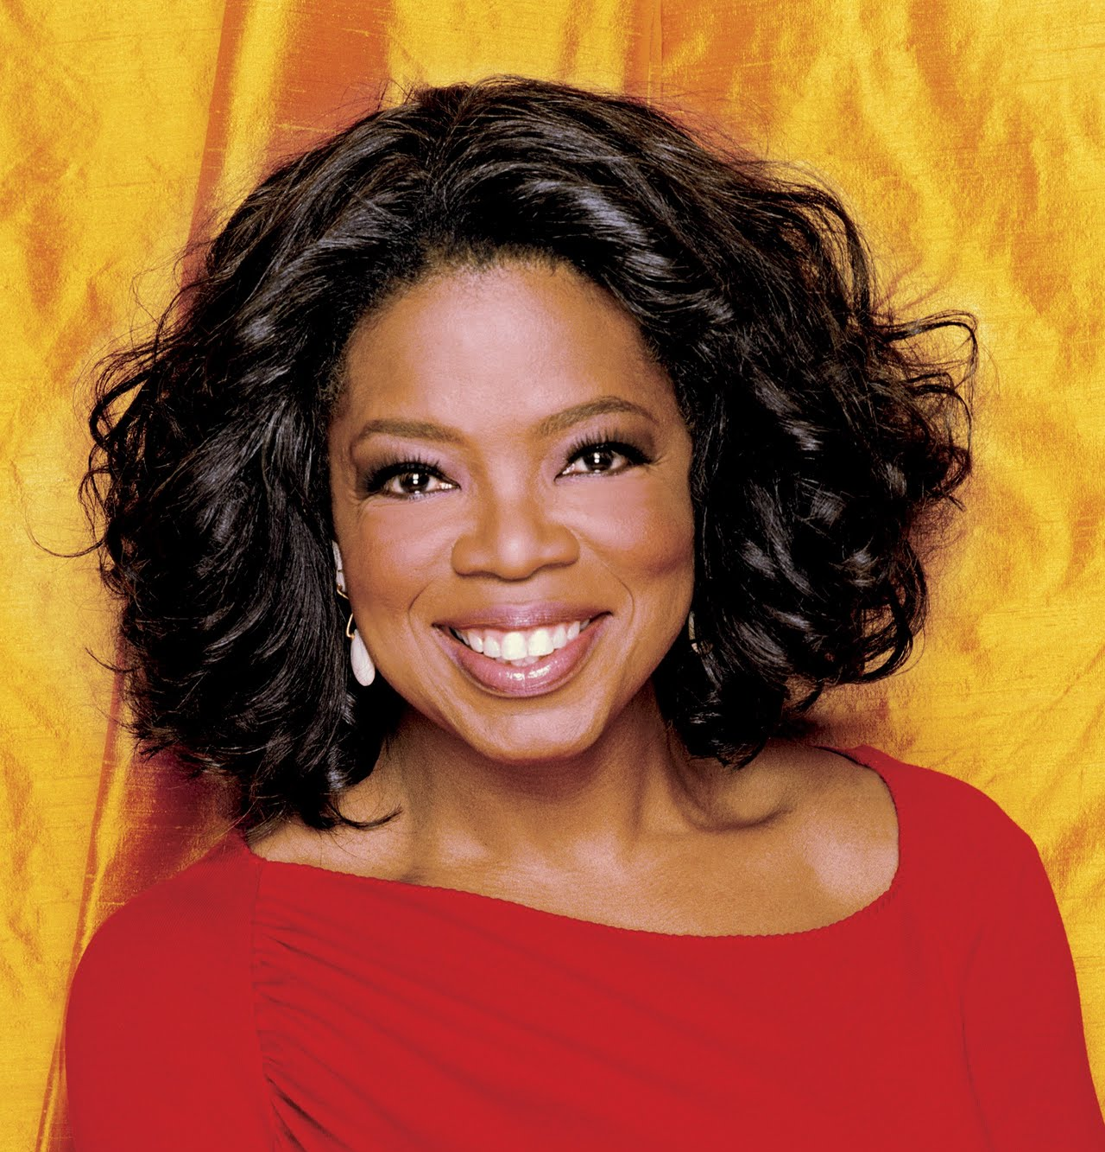
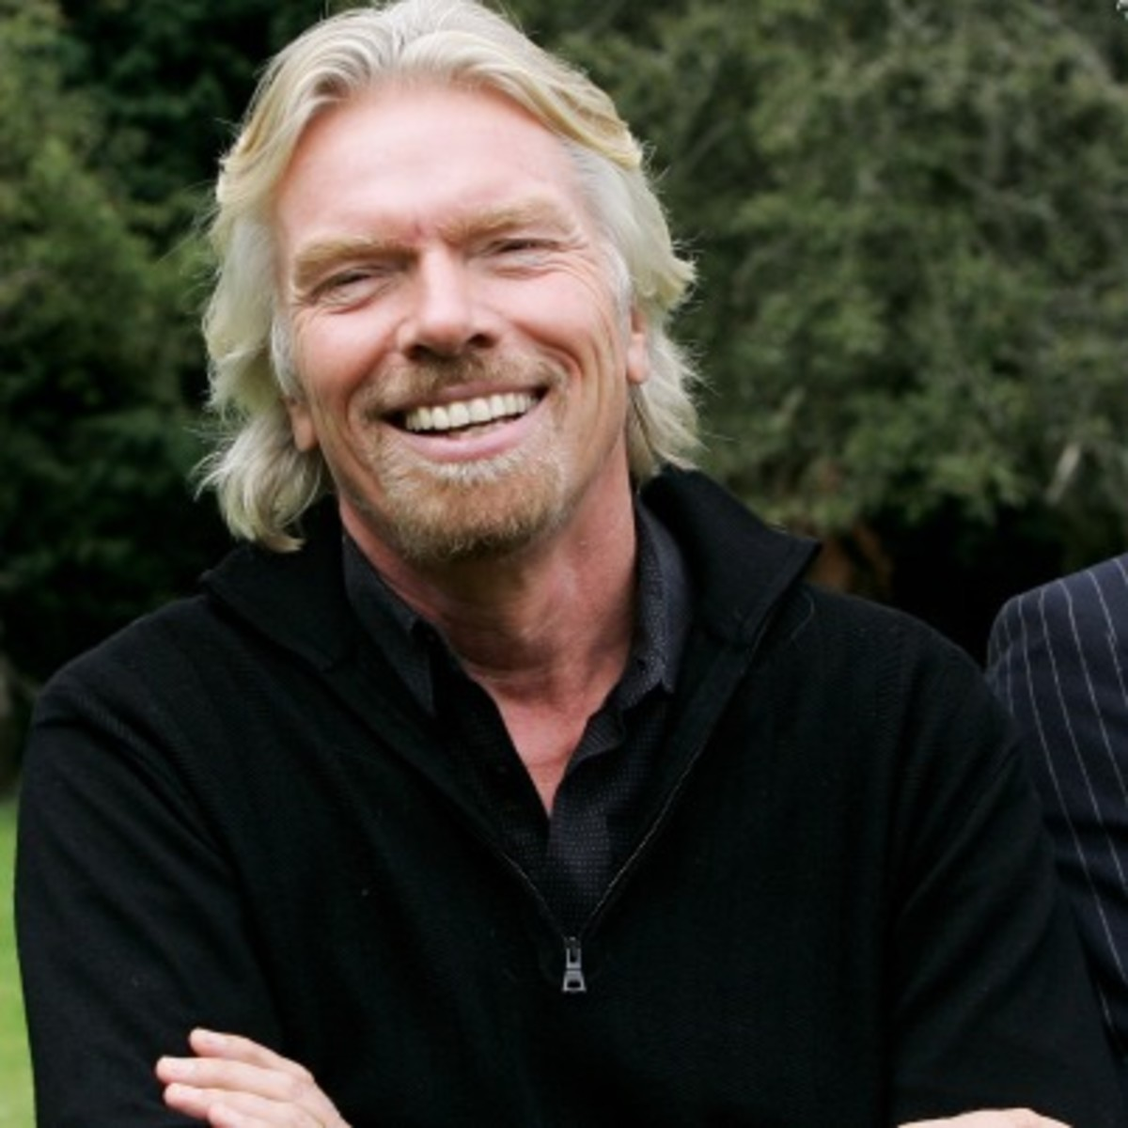
Examples of Successful Purpose Statements
To be a teacher. And to be known for
inspiring my students to be more than they
thought they could be.
Oprah Winfrey
To have fun in my journey through life and
learn from my mistakes.
Richard Branson

Slide 14

What is your Purpose?

Slide 15

Why do I need a personal stakeholder model?

Slide 16
Key Attributes of a Personal Stakeholder Model
Specific
Measurable
Impactful
Actionable

Slide 17

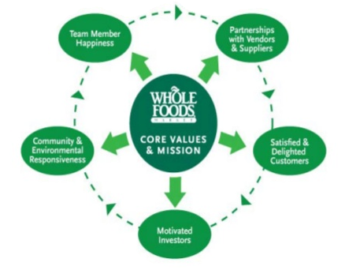
Examples of Successful Stakeholder Models

Slide 18
What is your Personal Stakeholder Model?

Slide 19
4Next Steps
Reflect on your purpose statement and stakeholder model
How do they align with your current employer?
How can you introduce conscious capitalism to you stakeholders?
What are some ways that you can measure your personal statement?
Read the book!

Slide 21
History of Conscious Capitalism
Conscious Capitalism Published
Firms of Endearment Written
Conscious Capitalism, Inc Founded
2007
2008
2009
2010
2011
2012
2013
2014
2015
2016
Community Chapters Developing in U.S. Cities
20 US Chapters
10 International
7 starting in 2016
International Chapters Developing
Conscious Capitalism translated into other languages

Slide 22





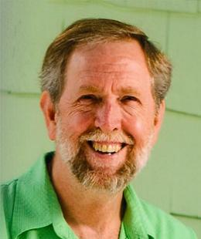
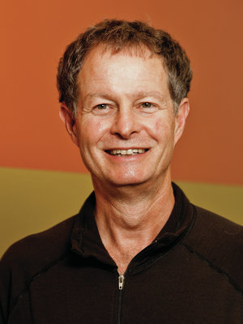
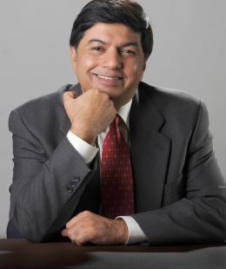
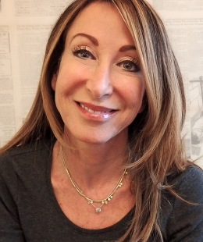
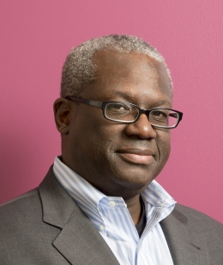
Key People and Companies
Companies
Visionary
Leader
Collaborator
People
Doug Rauch Previous CEO Trader Joes
John Mackey CEO
Whole Foods
Raj Sisodia Adjunct Professor Babson University
Cheryl Rosner Founder & CEO Stayful
James White Former CEO, Jamba Juice Inc.

Slide 23
Additional Conscious Capitalism Resources
Conscious Capitalism - http://www.consciouscapitalism.org/
Conscious Capitalism Summit - http://bit.ly/2cx6BA0
Conscious Capitalism (Book) - http://amzn.to/29r1s9i
Firms of Endearment (Book – Raj Sisodia) - http://amzn.to/2cx1os2
John Mackey on Conscious Capitalism - http://bit.ly/2cnAsb5
Raj Sisodia Blog - http://rajsisodia.com/
The Entrepreneur Magazine - http://entm.ag/2cwfxYr
Harvard Business Review - http://bit.ly/1H6Zp1E
Columbus Conscious Business Series - http://bit.ly/2cYgSDy
If you are interested in participating in the Central Ohio Conscious Capitalism Chapter, please email Mark.Kovacevich@improving.com

